Slide 1

Current Affairs
Session : 2

Slide 2
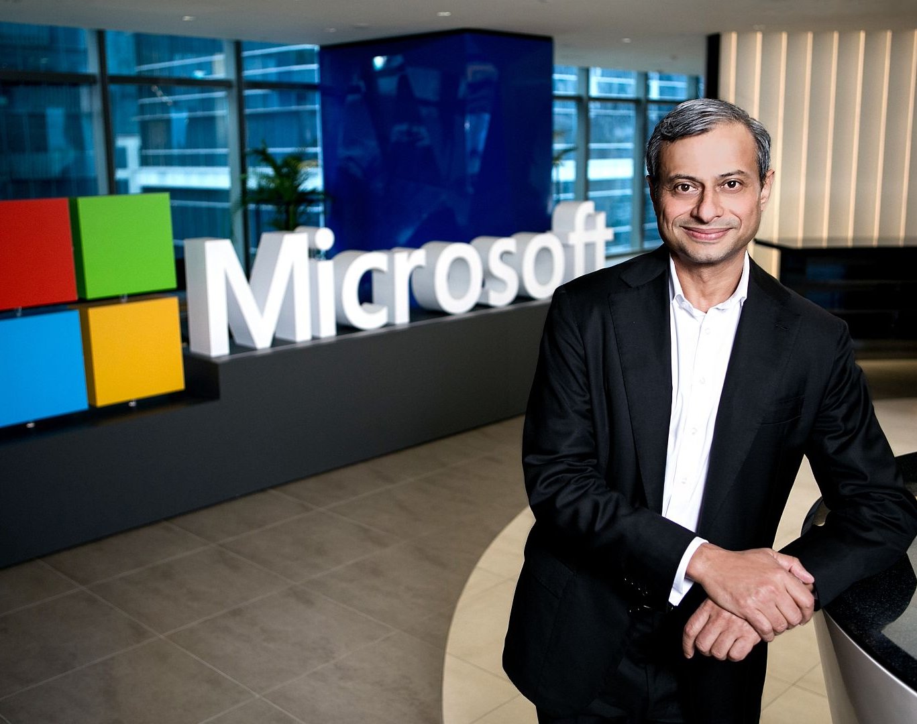
Microsoft appoints Ahmed Mazhari as new President for Asia
Mazhari joins Microsoft following 23 years at GE and Genpact (a spin off from GE in 2005)
Ahmed has lived and worked in the US, Asia and Europe and has a strong track record in leading global and regional teams.
Prior to Genpact, Mazhari held senior leadership roles with Xerox.
Mazhari holds a Bachelor of Engineering in Mechanical Engineering from the Motilal Nehru National Institute of Technology, India.

Slide 3
Using AI to advance the health of people and communities around the world
Microsoft Launch “AI for Health”, a new $40 million, five-year program to empower researchers and organizations with AI to improve the health of people and communities around the world.
AI for Health is the fifth Microsoft AI for Good program, a $165 million initiative to empower researchers, nonprofits and organizations with advanced technologies to help unlock solutions to the biggest challenges facing society today.
The AI for Health initiative will focus on three key areas:
Quest for discovery. Accelerating medical research to advance prevention, diagnoses and treatment of diseases
Global health insights. Increasing our shared understanding of mortality and longevity to protect against global health crises
Health equity. Reducing health inequity and improving access to care for underserved populations

Slide 4


Slide 5
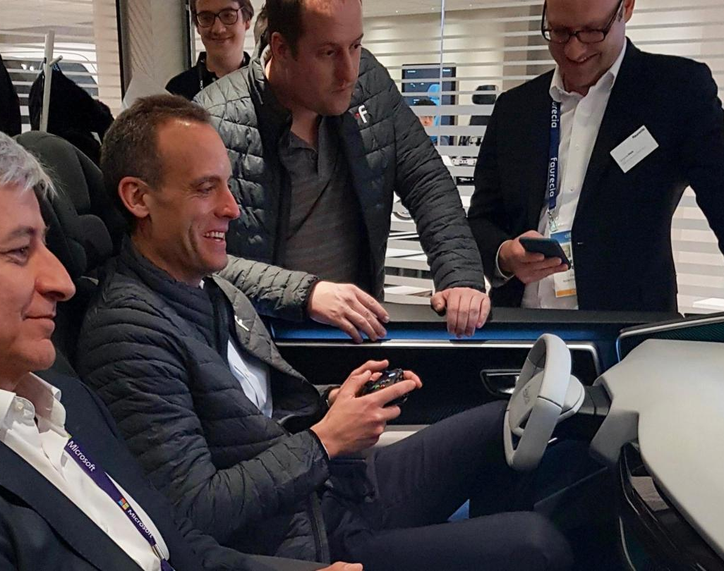
Microsoft will drive mobility in the next decade
As we embark upon a new decade, the automotive industry is reaching the most transformative point in its long, pre-digital history. It is predicted that by 2030, there will be a $4 trillion opportunity focused on new mobility services, as the automotive and transportation sectors converge.
Jean-Philippe Courtois, Microsoft executive vice president, and president of Global Sales, Marketing and Operations, experiences Faurecia’s cockpit demo at CES 2020.

Slide 6
Re-inventing the in-vehicle experience
Faurecia, a global leader in automotive technology, is collaborating with Microsoft to develop services that improve comfort, wellness and infotainment, as well as bring digital continuity from the home or office to the car, through access to content on demand or through collaborative working platforms.
Cerence, a global leader in creating unique, moving experiences for the automotive world, is working with Microsoft to integrate Cerence Drive products with the Microsoft Connected Vehicle Platform (MCVP).
Speeding up the drive to full autonomy
IHS Markit, a world leader in critical information, analytics and solutions, cites significant growth in the availability and standardization of advanced driver-assistance systems (ADAS) and automated driving, as people become more comfortable with these technologies.
Elektrobit, an award-winning global supplier of embedded and connected software products and services for the automotive industry, accelerates development of ADAS and AD systems with a new, cloud-based, end-to-end solution for software validation.

Slide 7
Pioneering the mobility experiences of the future -
AerOS, will give fleet operators a 360-degree view into their aircraft fleet. By leveraging technologies like AI and IoT, AerOS provides powerful capabilities like fleet master scheduling and real-time aircraft monitoring, enhancing Bell’s Mobility-as-a-Service (MaaS) experience
FlashParking, a leader in parking technology, has unveiled their Mobility Hub Operating System, a platform built on Microsoft Azure that is powering the evolution of isolated parking assets into connected mobility hubs that are more efficient, intelligent and adaptable than the garages and surface lots of the past.
Merging advanced technologies to power the future of the automotive industry –
ZF Friedrichshafen is transforming into a provider of software-driven mobility solutions
LG Electronics is working with Microsoft to build its automotive infotainment systems, building management systems and other business-to-business collaborations.
Accelerating the connected vehicle opportunity
Microsoft is working with Tom Tom and Moovit, Volkswagon, Renault, Erricsson, Luxoft, Ford and many more company to enhance Microsoft Connected Vehicle Platform(MCVP)

Slide 8
Microsoft DevBlogs

Slide 9
Feb-13 - This week Microsoft spent time to interact with the community both through a live, online Dual-Screen Developer Day event and in a closed industry event called the Microsoft Dual-Screen Software Design Review event here in Redmond. You can look detail at - https://developer.microsoft.com/en-us/microsoft-365/virtual-events
Feb-13 - Windows Terminal Preview v0.9 Release- This is the last version of the Terminal that will include new features before the v1 release. Any version of PowerSell can detect automatically. Detail can be viewed at - https://devblogs.microsoft.com/commandline/windows-terminal-preview-v0-9-release/
Visual Studio Blog
Python in Visual Studio Code – February 2020 Release
Decompilation of C# code made easy with Visual Studio
Have you ever experienced an exception occurring in a 3rd party .NET assembly but had no source code to figure out why? You can now use Visual Studio to decompile managed code even if you don't have the symbols, allowing you to look at code, inspect variables and set breakpoints.
Feb-12 - Creating .NET Core global tools on macOS - One of the really cool aspects about .NET Core is the support for global tools. You can use global tools to simplify common tasks during your development workflow. For example, you can create tools to minify image assets, simplify working with source control. Details at - https://devblogs.microsoft.com/visualstudio/creating-net-core-global-tools-on-macos/

Slide 10
Last week Jan 2019- Visual Studio 2019 version 16.5 Preview 2 was released, bringing many new features and improvements for developers in Visual Studio to help you build better software faster. Please read some highlights of new features and improved developer experiences in this page. Detail can be view at - https://devblogs.microsoft.com/visualstudio/whats-new-in-visual-studio-2019-version-16-5-preview-2-for-cpp-xamarin-and-azure-tooling-experiences/
Last Week Jan 2019 - Getting Started with Blazor Server Apps in Visual Studio for Mac- In Visual Studio 2019 for Mac v8.4 one of the big things that we added support for is developing Blazor Server Applications. In this post I’ll show you how you can get started building new Blazor Server applications with Visual Studio for Mac.
SQL server Blog
13 Feb 2020 - The February 2020 release of Azure Data Studio is now available. Detail can be look at - https://cloudblogs.microsoft.com/sqlserver/2020/02/13/the-february-2020-release-of-azure-data-studio-is-now-available/
29 Jan 2020 - The ultimate performance for your big data with SQL Server 2019 Big Data Clusters - Microsoft SQL Server 2019 Big Data Cluster enables intelligence over all your data and helps remove data silos by combining both structured and unstructured data across the entire data estate. Big Data Clusters integrates Microsoft SQL Server and the best of big data open-source solutions. It is deployed on scalable clusters using Apache Spark, HDFS containers with Kubernetes, and SQL Server. Detail can be viewed at - https://cloudblogs.microsoft.com/sqlserver/2020/01/29/the-ultimate-performance-for-your-big-data-with-sql-server-2019-big-data-clusters/
17 Dec 2019 - Improvements to machine learning capabilities in SQL Server 2019 – Details at https://cloudblogs.microsoft.com/sqlserver/2019/12/17/improvements-to-machine-learning-capabilities-in-sql-server-2019/

